Slide 1
Business Research Process
Chapter 4
Business Research Methods - William G. Zikmund

Slide 2
Decision Making
business opportunity is a situation that makes some potential competitive advantage possible
A business problem is a situation that makes some significant negative consequence more likely
An increase in employee turnover is generally only a symptom of a business problem, rather than the problem itself. Research may help identify what is causing this symptom so that decision makers can actually attack the problem, not just the symptom
Decision making is the process of developing and deciding among alternative ways of resolving a problem or choosing from among alternative opportunities
Sudha Bhagavatheeswaran, Department of Information Technology,
SIES College of Arts, Science & Commerce (Autonomous)

Slide 3
Absolute ambiguity to complete certainty
Complete certainty means that the decision maker has all information needed to make an optimal decision
perfect certainty, especially about the future, is rare.
Uncertainty means that the manager grasps the general nature of desired objectives, but the information about alternatives is incomplete.
Predictions about forces that shape future events are educated guesses.
Ambiguity means that the nature of the problem itself is unclear. Objectives are vague and decision alternatives are difficult to define.
This is by far the most difficult decision situation, but perhaps the most common.
Sudha Bhagavatheeswaran, Department of Information Technology,
SIES College of Arts, Science & Commerce (Autonomous)

Slide 4
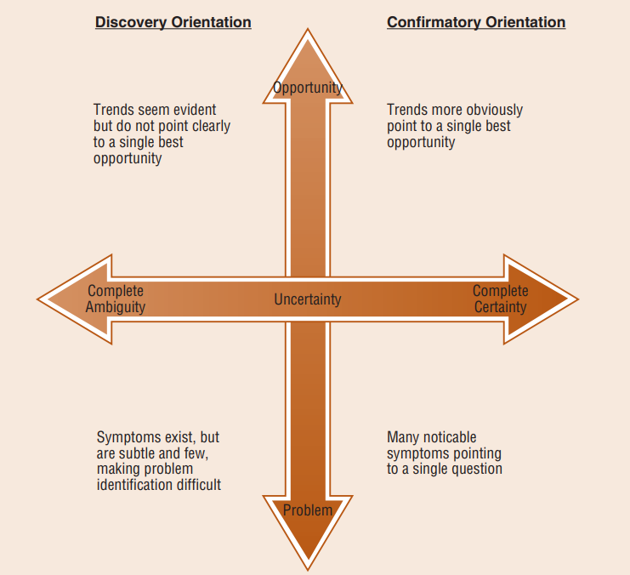
Sudha Bhagavatheeswaran, Department of Information Technology,
SIES College of Arts, Science & Commerce (Autonomous)

Slide 5
Types of Business Research
Exploratory Research
Exploratory research is conducted to clarify ambiguous situations or discover potential business opportunities. Exploratory research is particularly useful in new product development
01
Descriptive Research
Descriptive Research
Describe characteristics of objects, people, groups, organizations, or environments. It addresses who, what, when, where, and how questions. Diagnostic Analysis.
02
Causal Research
Causal research seeks to identify cause and-effect relationships.
03
Notes:
© Copyright PresentationGO.com – The free PowerPoint and Google Slides template library

Slide 6
Causality
Causal Inference :- A conclusion that when one thing happens, another specific thing will follow
Three criteria for causality.
Causal research should do all of the following:
  Establish the appropriate causal order or sequence of events
  Measure the concomitant variation between the presumed cause and the presumed effect
  Examine the possibility of spuriousness by considering the presence of alternative plausible causal factor
Sudha Bhagavatheeswaran, Department of Information Technology,
SIES College of Arts, Science & Commerce (Autonomous)

Slide 7



Criteria for Causality
01
02
03
Temporal Sequence
Concomitant Variance
Nonspurious Association
Deals with the time order of events—the cause must occur before the effect.
Occurs when two events “covary,” meaning they vary systematically
Means any covariation between a cause and an effect is true and not simply due to some other variable.
Notes:
© Copyright PresentationGO.com – The free PowerPoint and Google Slides template library

Slide 8
Degree of Causality
Absolute Causality - Means the cause is necessary and sufficient to bring about the effect
Conditional Causality - Means that a cause is necessary but not sufficient to bring about an effect.
Contributory causality - Means that a cause need be neither necessary nor sufficient to bring about an effect.
Sudha Bhagavatheeswaran, Department of Information Technology,
SIES College of Arts, Science & Commerce (Autonomous)

Slide 9
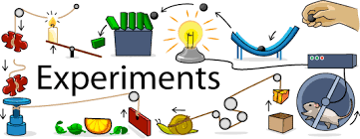
EXPERIMENTS
Experiments hold the greatest potential for establishing cause-and-effect relationships.
Experiment - A carefully controlled study in which the researcher manipulates a proposed cause and observes any corresponding change in the proposed effect.
An experimental variable represents the proposed cause and is controlled by the researcher by manipulating it.
Manipulation means that the researcher alters the level of the variable in specific increments.
Test-marketing is a frequently used form of business experimentation.
A test-market is an experiment that is conducted within actual business conditions.
Sudha Bhagavatheeswaran, Department of Information Technology,
SIES College of Arts, Science & Commerce (Autonomous)

Slide 10
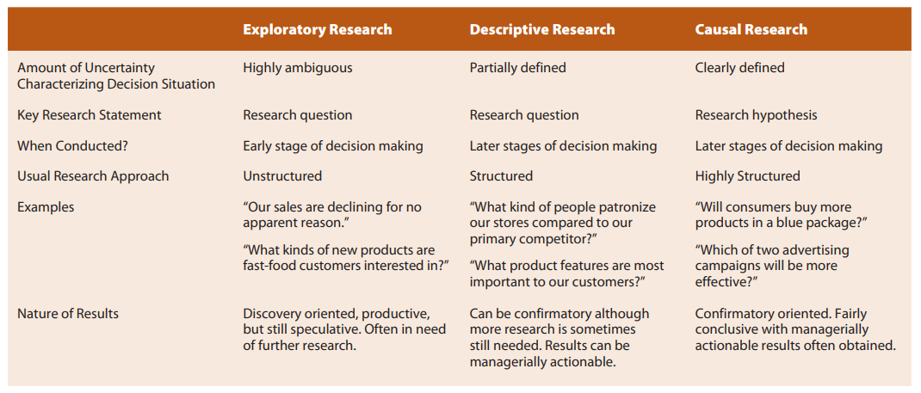
Uncertainty Influences the Type of Research
Sudha Bhagavatheeswaran, Department of Information Technology,
SIES College of Arts, Science & Commerce (Autonomous)

Slide 11
Stages in the Research Process
Defining the research objectives
Planning a sample
Analyzing the data
01
03
05
02
04
06
Planning a research design
Collecting the data
Formulating the conclusions and preparing the report
Sudha Bhagavatheeswaran, Department of Information Technology,
SIES College of Arts, Science & Commerce (Autonomous)

Slide 12
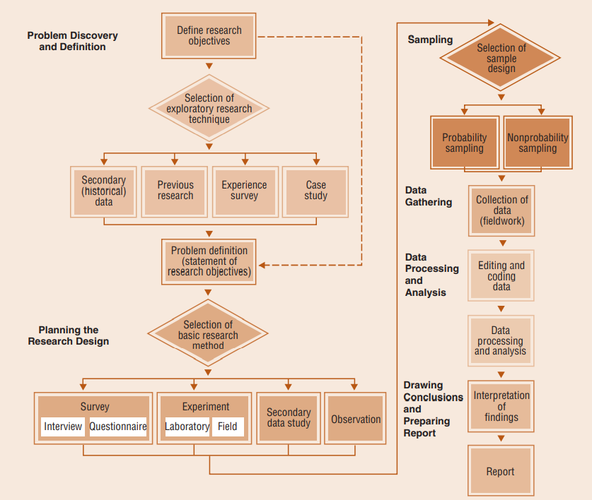
01
03
04
02
05
06

Slide 13
Defining the research objectives
Research objectives are the goals to be achieved by conducting research.
In consulting, the term deliverables is often used to describe the objectives to a research client.
The research objective may be to simply clarify a situation, define an opportunity, or monitor and evaluate current business operations.
This process is oriented more toward discovery than confirmation or justification
Defining the decision situation must precede the research objectives
Sudha Bhagavatheeswaran, Department of Information Technology,
SIES College of Arts, Science & Commerce (Autonomous)

Slide 14
Defining the research objectives
Exploratory research : previous research, pilot study
Previous research :
  Literature Review: A directed search of published works, including periodicals and books, that discusses theory and presents empirical results that are relevant to the topic at hand. It is a fundamental requirement of a research report.
Pilot Study: A small-scale research project that collects data from respondents similar to those to be used in the full study.
  A pretest is a very descriptive term indicating a small-scale study in which the results are preliminary and intended only to assist in design of a subsequent study.
  Focus Group: A small group discussion about some research topic led by a moderator who guides discussion among the participants.
Sudha Bhagavatheeswaran, Department of Information Technology,
SIES College of Arts, Science & Commerce (Autonomous)

Slide 15
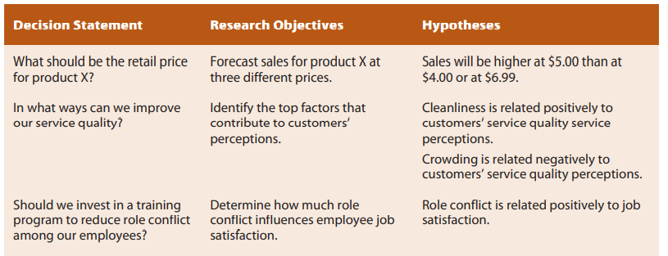
Defining the research objectives
formally state the research objectives
Linking Decision Statements, Research Objectives, and Research Hypotheses
Sudha Bhagavatheeswaran, Department of Information Technology,
SIES College of Arts, Science & Commerce (Autonomous)
Sudha Bhagavatheeswaran, Department of Information Technology,
SIES College of Arts, Science & Commerce (Autonomous)

Slide 16
Planning the Research Design
A research design is a master plan that specifies the methods and procedures for collecting and analyzing the needed information. A research design provides a framework or plan of action for the research.
Selection of basic research method
Sudha Bhagavatheeswaran, Department of Information Technology,
SIES College of Arts, Science & Commerce (Autonomous)

Slide 17

Sampling
Sampling involves any procedure that draws conclusions based on measurements of a portion of the population
Who is to be sampled?
How big should the sample be?
Select the sampling units
Sudha Bhagavatheeswaran, Department of Information Technology,
SIES College of Arts, Science & Commerce (Autonomous)

Slide 18

Gathering Data
Obtrusive Methods
  Surveys require direct participation by research respondents.
  This may involve filling out a questionnaire or interacting with an interviewer.
Unobtrusive methods
Sudha Bhagavatheeswaran, Department of Information Technology,
SIES College of Arts, Science & Commerce (Autonomous)

Slide 19

Processing and Analyzing Data
Editing: checking the data collection forms for omissions, legibility, and consistency in classification
Coding: The rules for interpreting, categorizing, recording, and transferring the data to the data storage media are called codes.
Data analysis: The application of reasoning to understand the data that have been gathered.
Sudha Bhagavatheeswaran, Department of Information Technology,
SIES College of Arts, Science & Commerce (Autonomous)

Slide 20

Drawing Conclusions and Preparing a Report
communicating the research results
interpreting the research results, describing the implications, and drawing the appropriate conclusions for managerial decisions
These conclusions should fulfill the deliverables promised in the research proposal.
Research is only as good as its applications.
Sudha Bhagavatheeswaran, Department of Information Technology,
SIES College of Arts, Science & Commerce (Autonomous)

